Slide 1
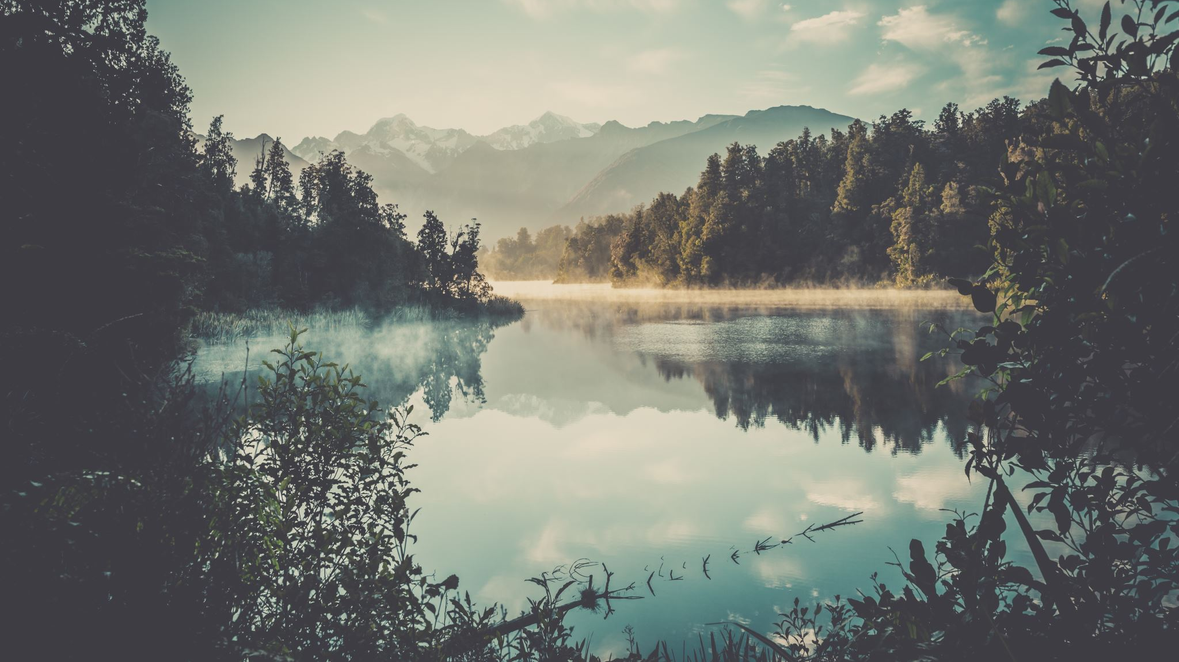
Bigfoot
Where will he appear next?

Slide 2

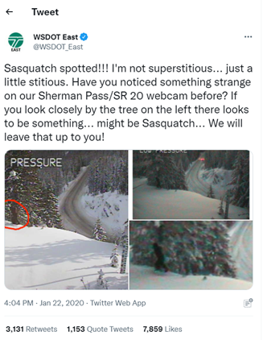
Bigfoot Basics
Native to North America
6-15 feet (2 to 4.5 meters) tall
Walks on two feet
Very hairy
Footprints measure 24inches (60 cm) in length, 8 inches (20cm) wide
Notes:
Bigfoot is an elusive creature native to North America. Bigfoots range in size from 6 to 15’ feet tall and are covered in hair. They are said to have a foul smell and sounds associated with them include shrieks, growls, and screams. The first published sighting of a Bigfoot was written up in the British Colonist newspaper of British Columbia. Here is one of the more recent sightings, by the Washington State Department of Transportation.
Our team decided to investigate the places that Bigfoots are often sighted to see if we could determine what factors contribute to a sighting and if we could use that information to predict where future sightings were likely to occur.

Slide 3
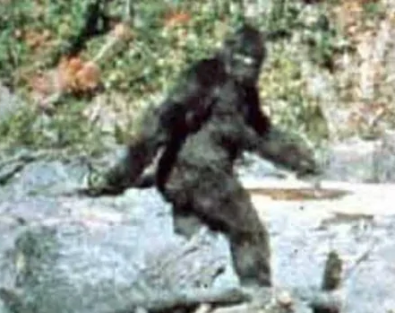
Questions
Why are Bigfoot Sighters in the woods?
Are they ok?
Notes:
Given that the majority of the documented Bigfoot sightings occur in the wilderness, we decided to consider why those who encountered him were out in the woods. Our intuition lead us to three things- population growth, camping and murder. We further wondered, those bigfoot sighters, are they high?
To answer those questions, we pulled dataset csvs from the US Census Bureau, US Campgrounds.info, The National Study on Drug Use and Health and the Bigfoot Researchers Organization , loaded them into juypter notebooks and standardized them to group by state and by the years from 2001-2020, with a focus on the 2020 data.

Slide 4
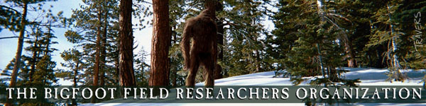



Sources
Bigfoot Sighting csv with observation, location, county, state, season, title, latitude, longitude, date, number, class code, temperature, dew point, humidity, cloud cover, moon phase, precipitation intensity, precipitation type, pressure, uv_index, visibility, wind bearing, wind speed
5 US Regional csvs with latitude, longitude, name, description, phone, rv information, facilities, reservations, pets, fees, directions from nearest city
Historical Population Change Data (1910-2020) csv with state, resident population and percent change by decade for the years 1910 through 2020
Table showing state, number of missing persons, missing persons per 100k residents on vivintsource.com compiled with info from US Census data and statistics from the National Missing & Unidentified Persons system converted to csv
Tabs from the National Survey on Drug Use and Health Excel file for alcohol use, illicit drug use, and substance abuse disorder. Each tab shows state and affected % of the state population by age group with an estimated percentage, and an upper and lower confidence level
Notes:
As Jenny mentioned we retrieved data from several sources. We retrieved a dataset from the BFRO with information regarding sightings - location, report description, and other variables such as weather. We condensed the data set to only include description and location.
We also retrieved 5 US Regional csvs with the name and location of campgrounds across the country and merged them into one dataset
We retrieved Historical Population Data from the census
Next we retrieved missing persons data from the National Missing & Unidentified Persons system and converted it to a csv.
Lastly we retrieved data from the National Survey on Drug Use and Health. We took data regarding alcohol use, ilicit drug use, and substance use disorder. Each tab shows state the rate of affected state population, we mainly focused on the adult population.

Slide 5

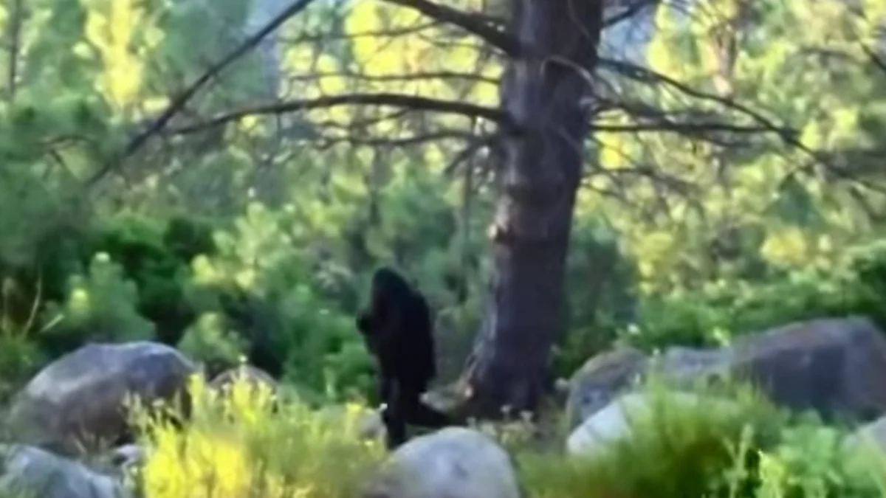


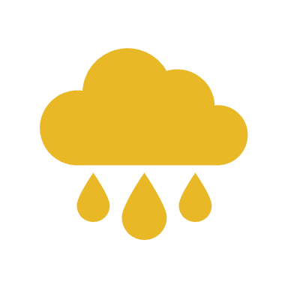


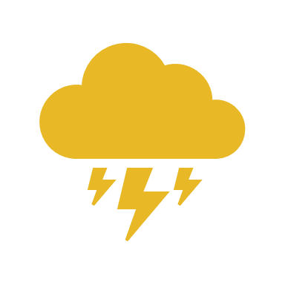
Ideal Sighting Conditions
Season: Summer or Fall
Temperature: 57 degrees
Humidity: 70%
Cloud cover: 40%
Precipitation intensity: clear to light rain/snow
Wind speed: 3mph, max of 23mph
Notes:
We parsed data from the Bigfoot Field Researchers Organization and determined the most common atmospheric conditions for Bigfoot sightings. They are most often seen in summer or fall when the temperature is around 57 degrees and they prefer a high humidity. They are most often seen on calm, clear days when the cloud cover is around 40%.

Slide 6

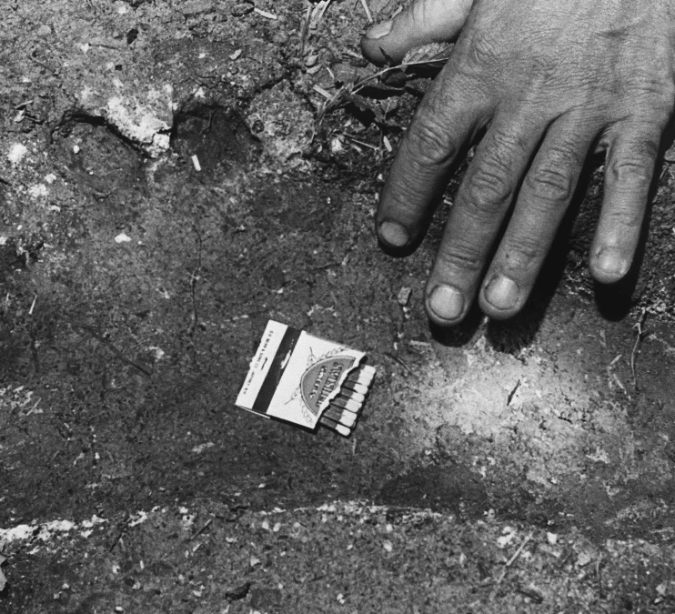
Tableau Visualizations
https://public.tableau.com/views/BigfootSightings_16463404441720/Bigfootvs_Campgrounds?:language=en-US&publish=yes&:display_count=n&:origin=viz_share_link
Notes:
Three maps were created using Tableau to compare Bigfoot Sightings and three variables. The variables are number of campgrounds per state, population per state, and rates of substance use disorder per state.
The first map shows the number of bigfoot sightings compared to the number of campgrounds per state. There appears to be a high number of sightings in Washington, a state with 576 campgrounds. The map also shows that Bigfoot sightings tend to appear near coasts and rivers
The next map shows bigfoot sightings among populated areas. As you can see the majority of bigfoot sightings are in states with higher population density.
The final map compares Bigfoot to rates of Substance Use Disorder per state, retrieved from the National Survey of Drug Use and Health. As we can see there are higher rates on the Pacific Northwest. However, states like Texas and Florida have lower rates of Substance Use Disorder. Since SUD is a diagnosis, it is possible that there is underreporting when it comes to substance use.
For further clarity a dashboard was created to compare the number of bigfoot sightings per state to the rate of illicit drug and alcohol use.

Slide 7
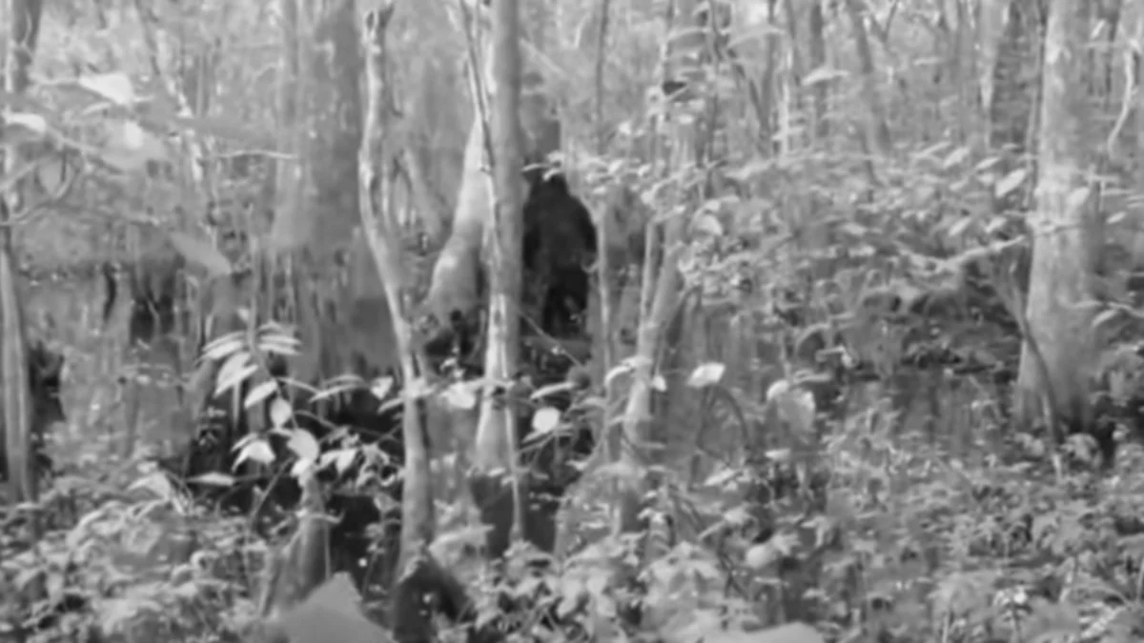
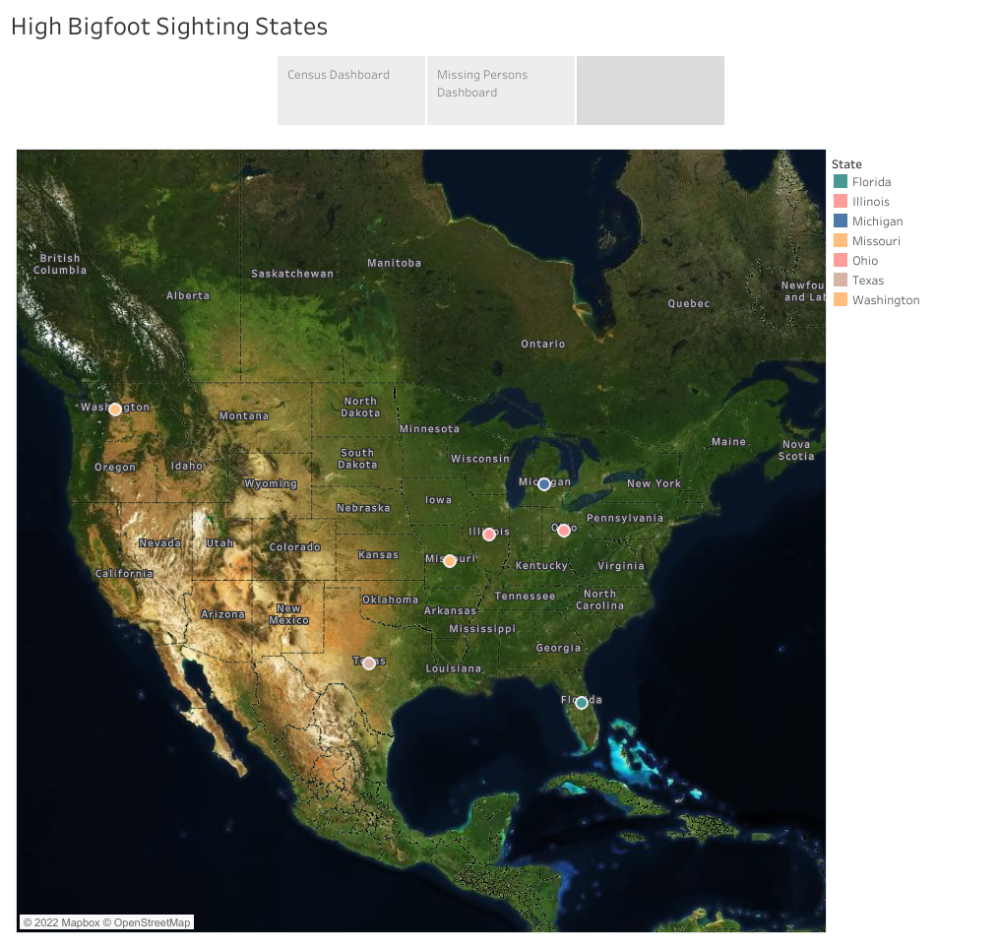



High Bigfoot Sighting States (HBFS)
Notes:
Using the BFRO data we identified the states with the highest numbers of bigfoot sightings over the 20-year period from 2001 to 2020. Those states are Florida, Illinois, Michigan, Missouri, Ohio, Texas, and Washington.

Slide 8
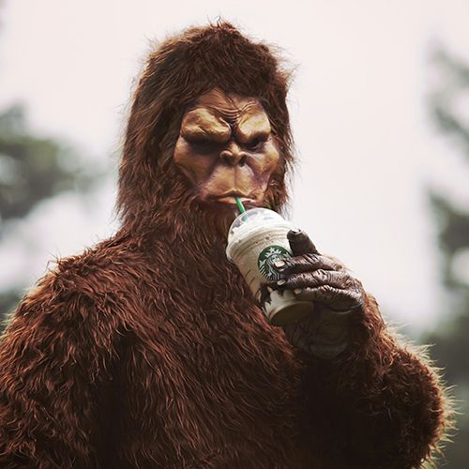
Washington!
Big Foot Sightings
Rank | State
1 | Washington
2 | Florida
3 | Texas
4 | Illinois
5 | Ohio
Number of Campgrounds
Rank | State
1 | California
2 | Oregon
3 | Washington
4 | Colorado
5 | Iowa
Missing Persons
Rank | State
1 | California
2 | Florida
3 | Texas
4 | Arizona
5 | Washington
Illicit Drug Use
Rank | State
1 | Colorado
2 | Washington
3 | Nevada
4 | Oregon
5 | Montana
Substance Use Disorder
Rank | State
1 | District of Columbia
2 | Colorado
3 | Washington
4 | Nevada
5 | Oregon

Slide 9
Machine learning
Goal: Predict the number of sightings per state given 8 different factors.
factors: illicit drug use, alcohol use, substance use disorder, missing people per 100,000 residents, number of campgrounds, and state
Model: Multiple regression model
Model Testing Score:0.085
This low score indicates that our model is unsuccessful. For further development of the model, we would add other factors such as weather, season, time of day.
Notes:
The goal of our machine learning model was to see if we could create a model that would be able to predict the number of sightings per state dependent on some key information on each of the states. We looked at 9 different factors. These factors were illicit drug use, alcohol use, substance use disorder, missing people per 100,000 residents, number of campgrounds, and state. We used a supervised machine learning multiple regression model. For our dependent variable we did number of sightings per state and our independent variables were our 8 different factors. We split our data into test and train data then ran our though our model. We received an r-square score of 0.085. This indicates to us that there are far more factors that contribute to the sightings than just the factors that have been added to our machine learning. Other factors that in the future we could take into consideration such as terrain, income, and number of other animal sightings.

Slide 10
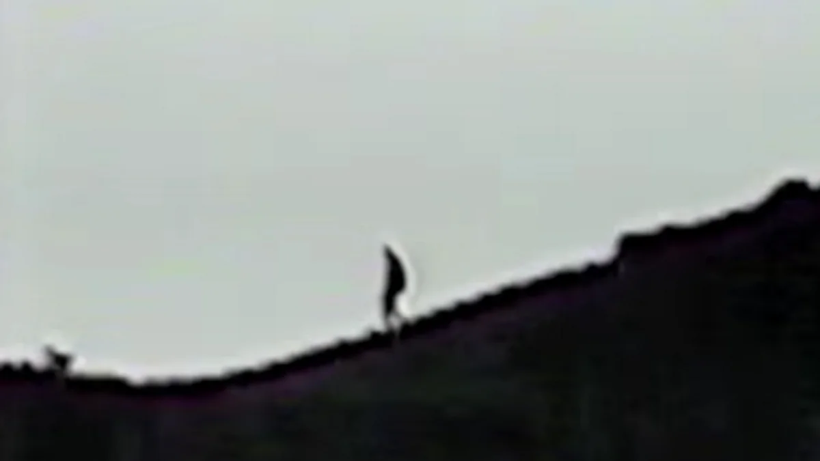
Website:
https://jennyshea.github.io/Where-Will-Big-Foot-Appear-Next/

Slide 11
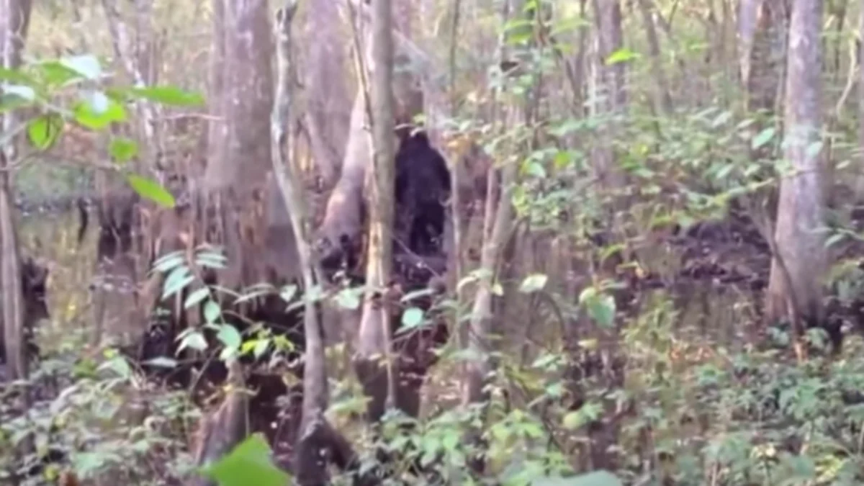
Further development ideas
“Mississippi resident Josh Highcliff captured video of this potential bigfoot while hunting on his property in 2013. Afraid to go back to the woods, he posted the footage to YouTube asking for help to identify the animal or for a prankster to come forward.”
Outsideonline.com/gallery/10-most-convincing-bigfoot-sightings
Notes:
-Is an increase in Bigfoot sightings correlated with an increase in other wildlife sightings?
-How will wildfires in the pacific northwest impact the number of Bigfoot sightings?
Does the HBFS distribution suggest a migratory pattern?
Is the percentage of the population over 18 impacted by drug alcohol use for Texas and Florida skewed over issues of access to healthcare/refusal of medicad expansion?
Model with more specific location details

Slide 12
Sources
https://www.britannica.com/topic/Sasquatch
https://www.livescience.com/24598-bigfoot.html
http://www.uscampgrounds.info/
https://www.vivintsource.com/smart-home-academy/2019-missing-persons-by-state/
https://www.census.gov/data/tables/time-series/dec/popchange-data-text.html
https://pdas.samhsa.gov/#/survey/NSDUH-2020-DS0001
https://www.outsideonline.com/gallery/10-most-convincing-bigfoot-sightings/

Slide 13
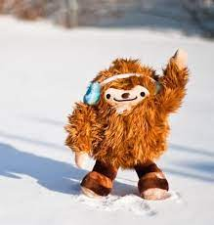
Questions?

